Slide 1
Lariat Rental Company
Eliminating unnecessary costs to uncover additional revenue and profits

Slide 2
Cars
We have 72 car makes (brands) in our national fleet of rental cars
With over 4000 models to choose from
How Many Different Makes
72
Total Cars in Inventory
268,159
How Many Different Models
4000
Total Average Cost Per Car
$ 8,269.17
Average Revenue Per Car
$16,216.51

Slide 3
Branches
Average Revenue Per Location
$1,297,320.80
Average Cost Per Location
$670,828.21
50 Locations nationwide
in 22 states
branch_id | city | state | airport_ind | # Cars Per Location | Total Revenue Per Branch | Total Cost Per Branch | Total Profit Per Branch
8 | Raleigh | North Carolina | TRUE | 1977 | $ 1,503,612.00 | $ 620,417.88 | $ 883,194.12
3 | Atlanta | Georgia | TRUE | 16281 | $ 1,555,289.00 | $ 620,417.88 | $ 934,871.12
35 | Washington | District of Columbia | TRUE | 4439 | $ 1,467,912.00 | $ 620,417.88 | $ 847,494.12
38 | Denver | Colorado | FALSE | 4394 | $ 1,387,929.00 | $ 712,695.24 | $ 675,233.76
12 | Yonkers | New York | FALSE | 2034 | $ 1,468,623.00 | $ 712,695.24 | $ 755,927.76

Slide 4
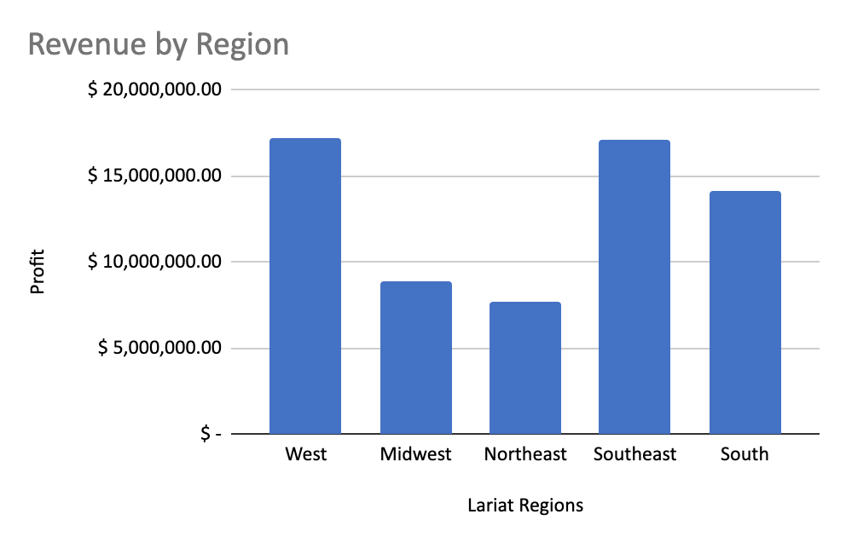
Baseline Calculations
Regions | Total Revenue By Branch
West | $ 17,161,060.00
Midwest | $ 8,878,286.00
Northeast | $ 7,652,526.00
Southeast | $ 17,034,405.00
South | $ 14,139,763.00

Slide 5
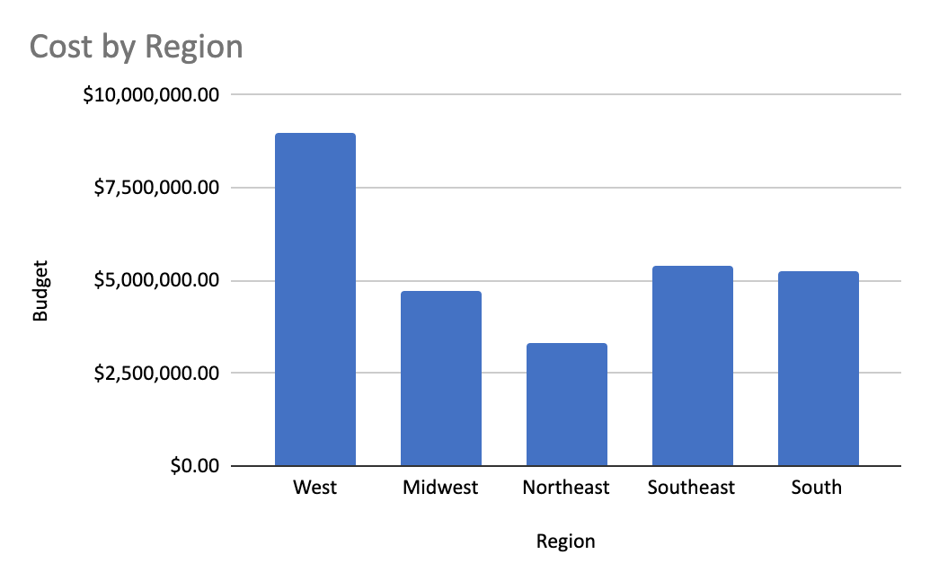
Baseline Calculations
Total Cost By Branch
$8,988,206.04
$4,712,034.60
$3,286,644.12
$5,370,684.96
$5,240,175.12
$ 37,268,295.16

Slide 6
My Strategy Proposal

Slide 7
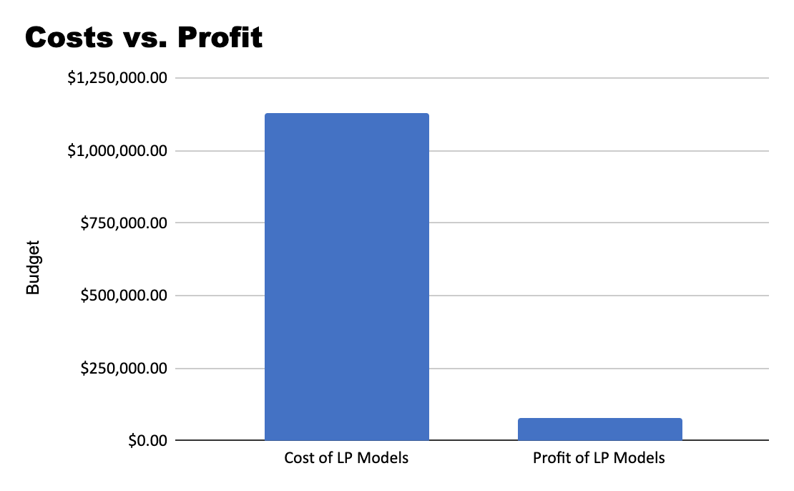
Phase 1:
How much cost vs revenue would we lose, if we were to discontinue some of our least performing models?
69949913 | 2018 Hyundai Santa Fe | $ 156.08 | $ 15,632.00 |  | $ 9,066.84
71361774 | 2016 Dodge Viper RT/10 | $ 160.72 | $ 16,422.00 |  | $ 8,861.88
73222399 | 2016 BMW 5 Series | $ 151.24 | $ 7,164.00 | X | $ 7,955.52
73878626 | 2017 Nissan Rogue | $ 158.00 | $ 16,636.00 |  | $ 9,389.52
# of LPM | Rev of LP Models | Cost of LP Models | Profit of LP Models
138 | $1,209,709.00 | $1,131,391.92 | $78,317.08

Slide 8
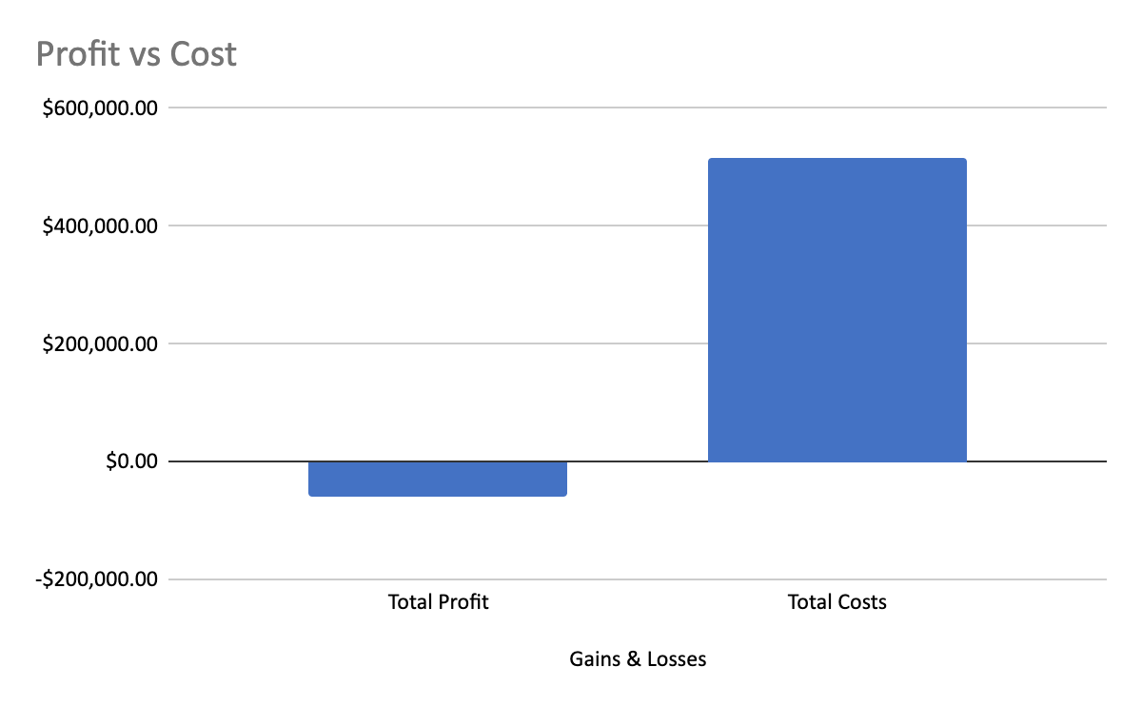
Phase 2:
How much money would the company save by eliminating all negative profit models?
596934548 | 2018 Mercedes-Benz 500SEL | $15,057.00 | $7,564.08 | $7,492.92
598458506 | 2017 Oldsmobile Toronado | $7,570.00 | $10,461.60 | -$2,891.60 | X
610517929 | 2018 Honda Civic | $8,429.00 | $10,389.00 | -$1,960.00 | X
612921824 | 2018 Isuzu Axiom | $14,895.00 | $9,494.40 | $5,400.60
How Many? | Total Profit | Total Costs
55 | -$58,090.72 | $514,095.72

Slide 9
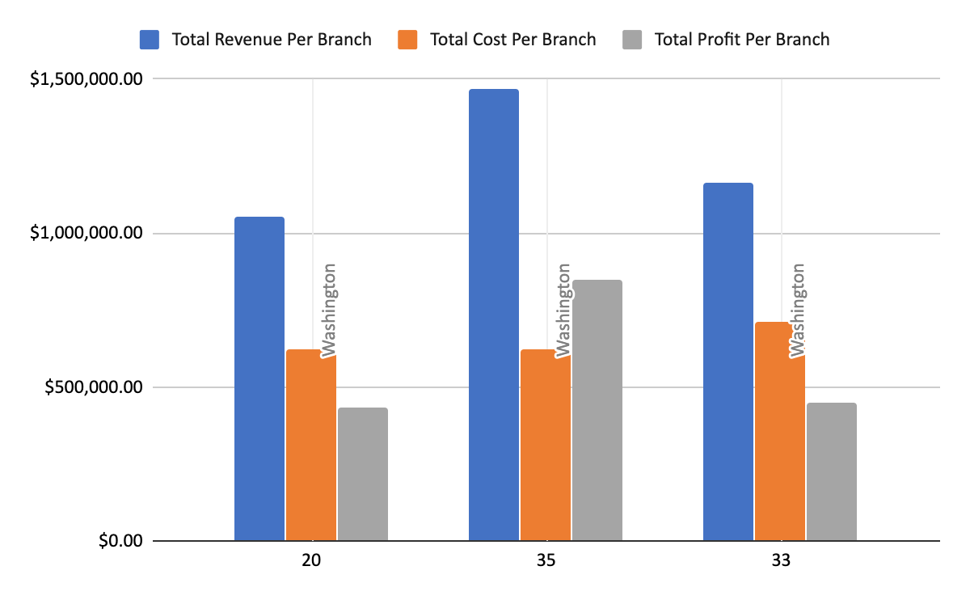
Phase 3:
Remove Washington D.C.'s third, and least performing branch.
Located in these Cities | # Locations in City
Washington D.C. | 3
Size of Washington D.C.
68.34 mi²
Selling Models=Additional Profit
branch_id | city | state | airport_ind | # Cars Per Location | Total Revenue Per Branch | Total Cost Per Branch | Total Profit Per Branch
20 | Washington | District of Columbia | TRUE | 1986 | $1,053,148.00 | $620,417.88 | $432,730.12
35 | Washington | District of Columbia | TRUE | 4439 | $1,467,912.00 | $620,417.88 | $847,494.12
33 | Washington | District of Columbia | FALSE | 4510 | $1,161,849.00 | $712,695.24 | $449,153.76

Slide 10
In Conclusion...
$2,265,905.52
-by implementing all three phases-

